Slide 1

Power BI Data Gateway
Bridging On-Premises Data and Power BI Cloud
By Sakina Neemuchwala

Slide 2
Presentation Objectives
Understanding the Gateway
Installation & Configuration
Hands-On Application
Demonstrating data refresh from a local Excel file.
What it is and why it's essential for Power BI.
Step-by-step guide to setting up your own Gateway.

Slide 3

What is a Power BI Data Gateway?
A Power BI Data Gateway acts as a secure software bridge between your on-premises data sources and the Power BI Service in the cloud.
It facilitates secure, efficient data transfer, enabling cloud-based Power BI reports to access and refresh data stored locally on your servers or machines.

Slide 4

Why Do We Need It?
Power BI Desktop
Directly accesses local files.
No gateway needed for initial development.
Power BI Service (Cloud)
Cannot directly access local/on-premises data.
Requires a secure conduit for refresh and live connections.
The Gateway is indispensable for enabling your cloud service to refresh and securely use local data, ensuring your reports are always up-to-date.

Slide 5
How Does It Work? (High-Level)
Installation
Secure Connection
Install the Gateway software on a machine that has access to your local data sources.
The Gateway establishes a secure outbound connection to the Power BI Service in the cloud.
Data Request
Data Transfer
Power BI Service sends a request for updated data to the Gateway.
The Gateway fetches the requested data from your local sources and securely transmits it back to Power BI Service.

Slide 6
Types of Power BI Gateways
Personal Mode
Designed for individual users, enabling personal refreshes of reports and datasets.
Standard (Enterprise) Mode
Supports shared use across multiple users, connecting to various data sources in an enterprise environment.
For our demonstration, we will be using the Standard (Enterprise) Mode due to its versatility and broader applicability in professional settings.

Slide 7
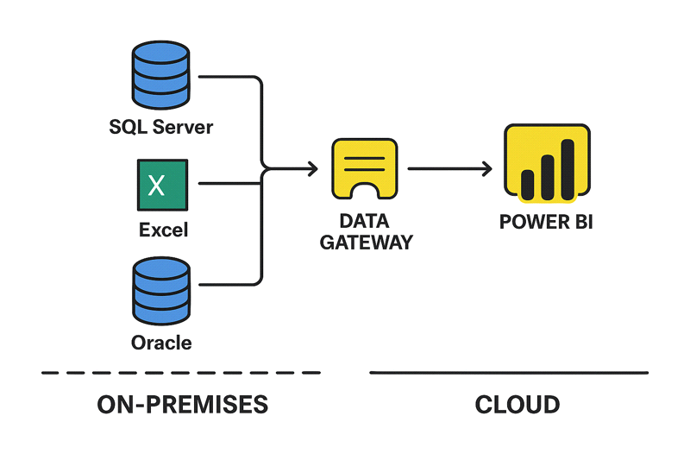

Slide 8




Hands-On Setup Overview
Install & Register Gateway
Build & Publish Report
Download and set up the Power BI Data Gateway on your local machine.
Create a Power BI report from a local Excel file and publish it to Power BI Service.
Configure Gateway
Schedule Refresh
Set up the Gateway connection and data source in Power BI Service.
Automate data refreshes for your published report.

Slide 9
Prerequisites for Our Demo
Windows PC: With active internet connection.
Gateway Installer: Download the Standard Mode installer from Microsoft's official site.
Power BI Desktop: Latest version installed.
Power BI Service Account: A valid account with publishing permissions.
Sample Excel File: SalesData.xlsx (will be provided).

Slide 10
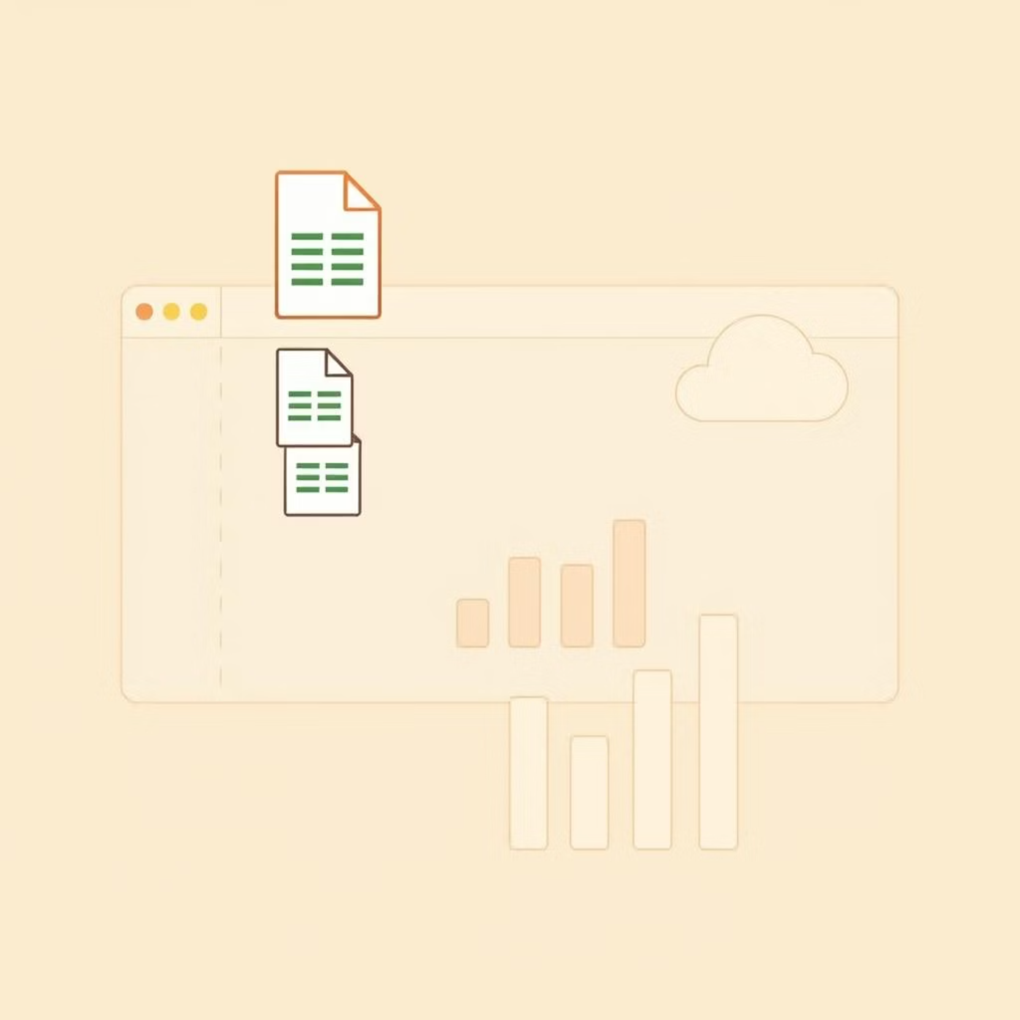
Step 1: Build & Publish Report
Place Data: Save SalesData.xlsx in a known folder, e.g., C:\GatewayDemo\.
Open Power BI Desktop: Start a new report.
Get Data: Select "Excel workbook" and load SalesData.xlsx.
Create Visualization: Build a simple chart, e.g., "Sales by Region."
Save & Publish: Save your file as a .pbix and publish it to your Power BI Service workspace.

Slide 11
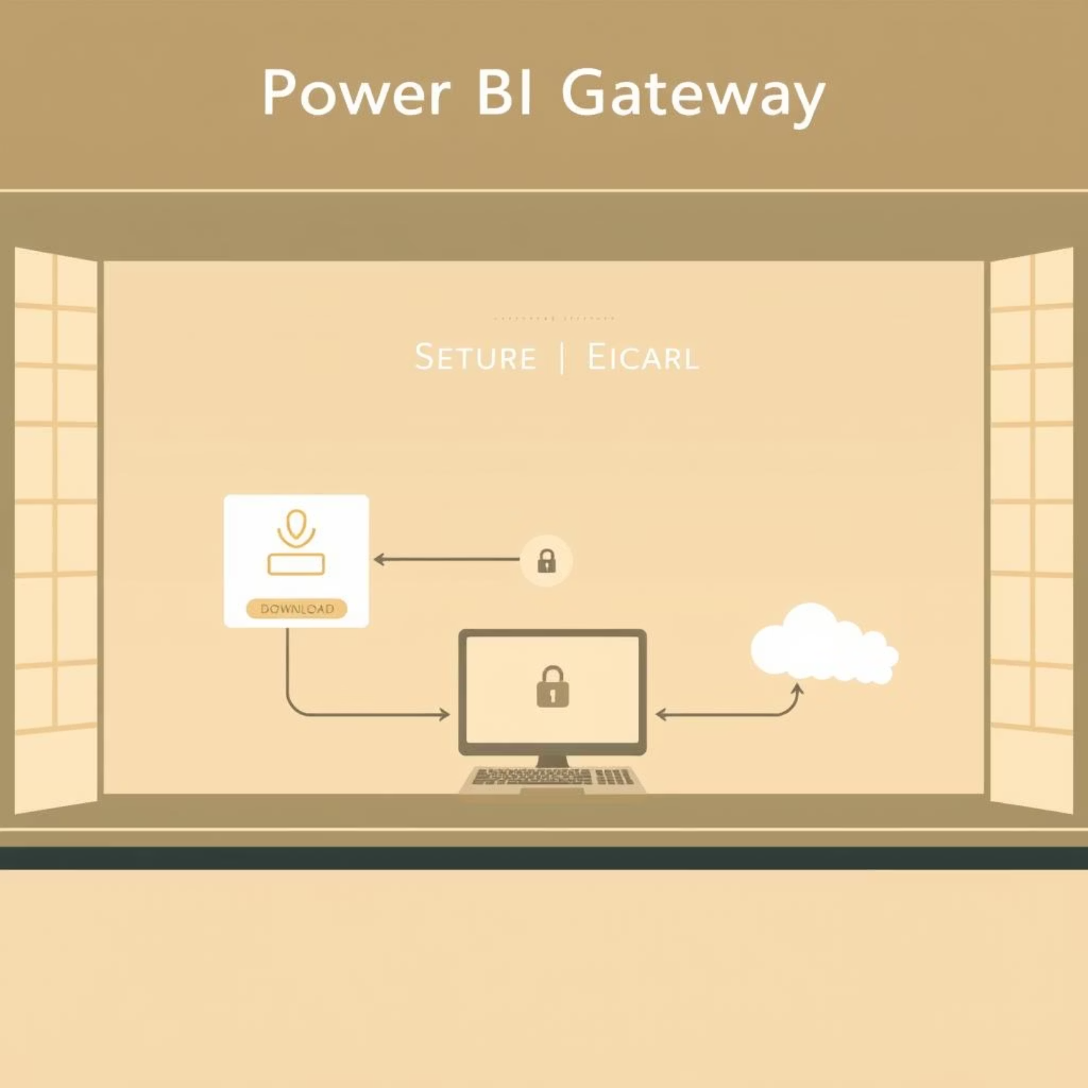
Step 2: Install & Configure Gateway
Download Installer: Get the Power BI Gateway (Standard Mode) installer. https://powerbi.microsoft.com/gateway/
Run Setup: Execute the installer and follow the prompts.
Sign In: Use your Power BI account credentials.
Register Gateway: Choose to register a new gateway on your current machine.
Name & Key: Assign a unique name to your gateway and create a strong recovery key. Keep it safe!
Complete: Finish the installation.

Slide 12
Step 2: Install & Configure Gateway
Configure Gateway in Power BI Service
1. Go to https://app.powerbi.com 2. Navigate to Settings → Manage Gateways 3. Click + New Data Source - Name: Sales Data Excel - Type: File - Path: C:\GatewayDemo\SalesData.xlsx - Authentication: Windows or Anonymous 4. Assign your report to this data source.

Slide 13
Step 4: Schedule Refresh
1. Go to the dataset in your workspace 2. Click on Schedule Refresh 3. Select your installed gateway 4. Set refresh times (e.g., every day at 8:00 AM) 5. Test the connection (should show “Success”)

Slide 14
Thank You !

